Slide 1
CONTENT
introduction of data
Data Wrangling
content
Exploratory Data Analysis
Formal Analysis
conclusion

Slide 2
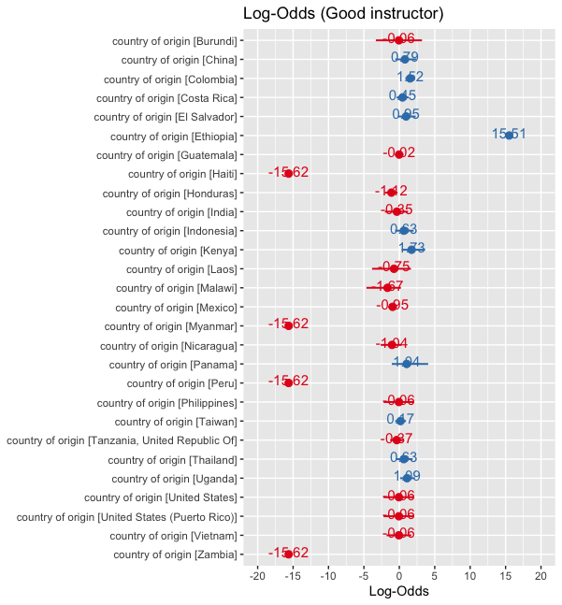
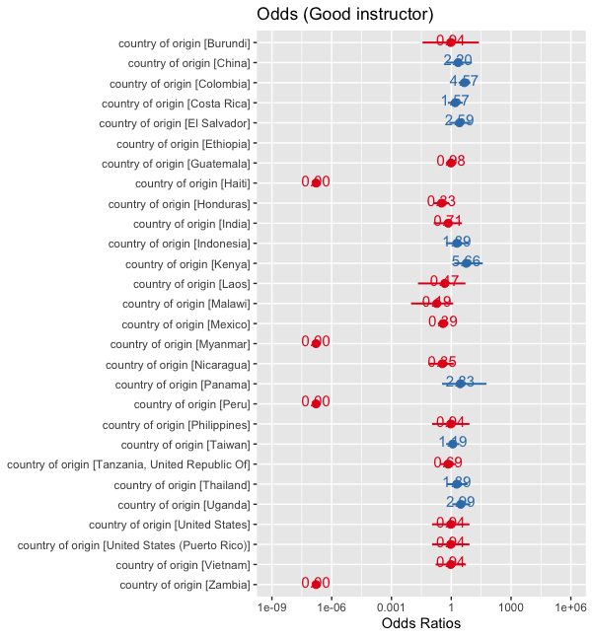


Exploratory Data Analysis
Country and Qualityclass
Log-odds: $\ln{\frac{p}{1−p}= α+β×country}⁡$
Odds: $\frac{p}{1−p}=exp(α+β×country)⁡$

Slide 3
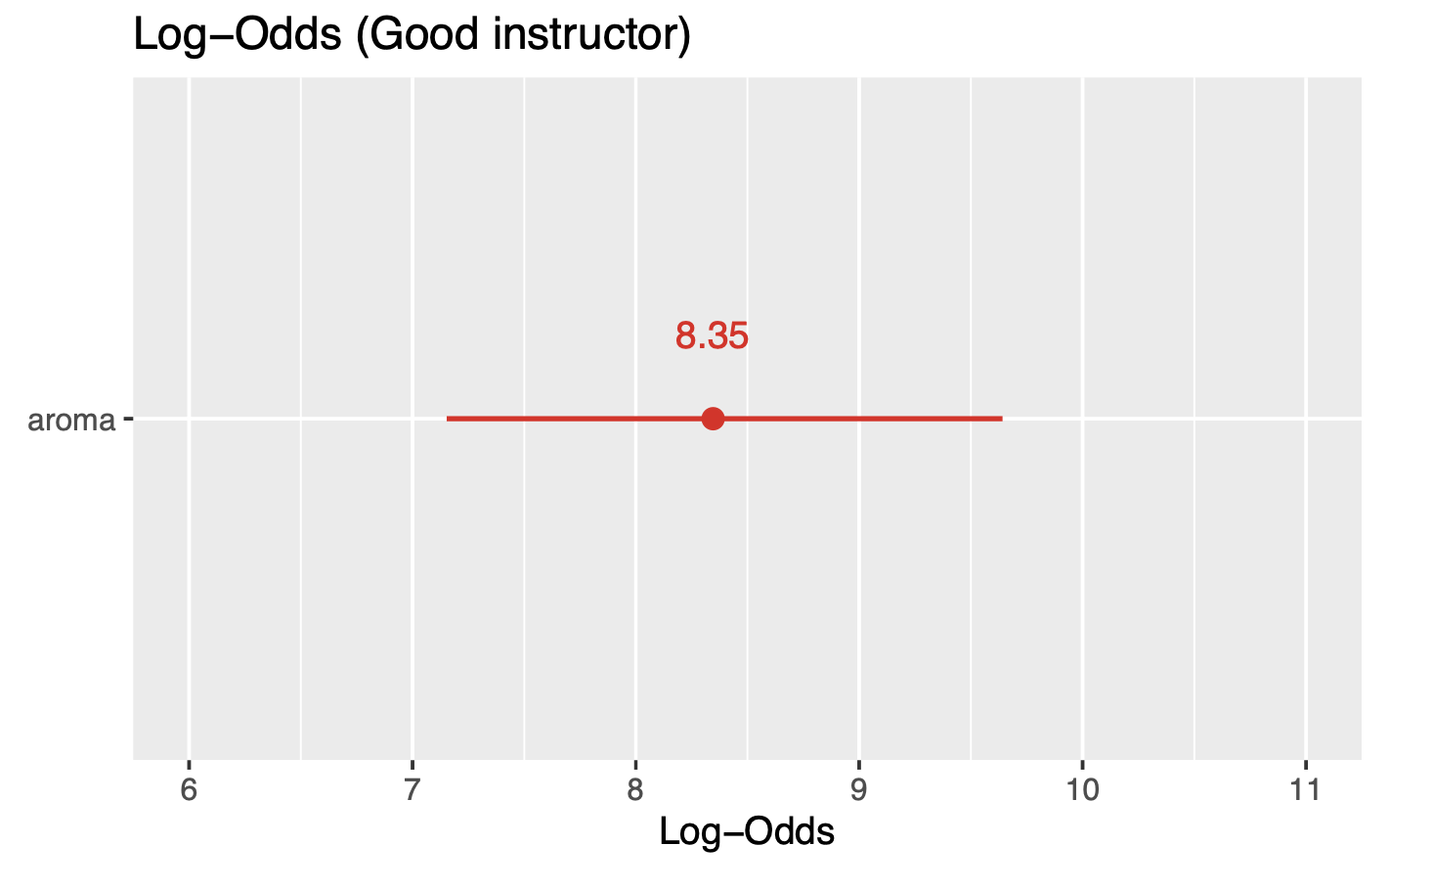
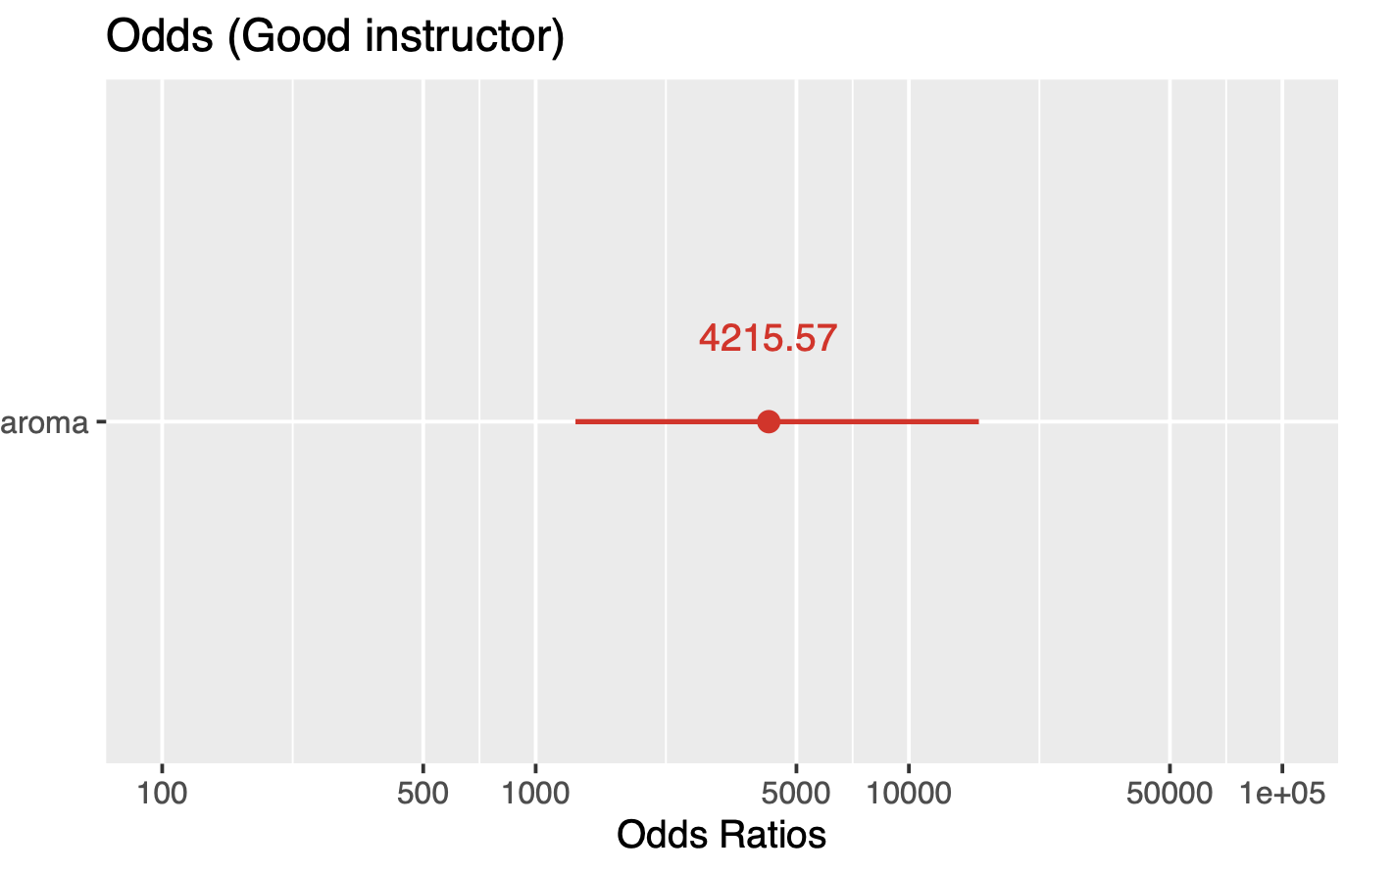


Exploratory Data Analysis
Aroma and Qualityclass
Log-odds: $\ln{\frac{p}{1−p}= α+β×aroma}⁡$
Odds: $\frac{p}{1−p}=exp(α+β×aroma)⁡$
( 7.10 , 9.59 )
( 1216.28 , 14610.92 )
The aroma significantly elevates the likelihood of being classified as a high-quality instructor, with odds ratios and log-odds reflecting a steep increase in probability as the aroma score improves.

Slide 4
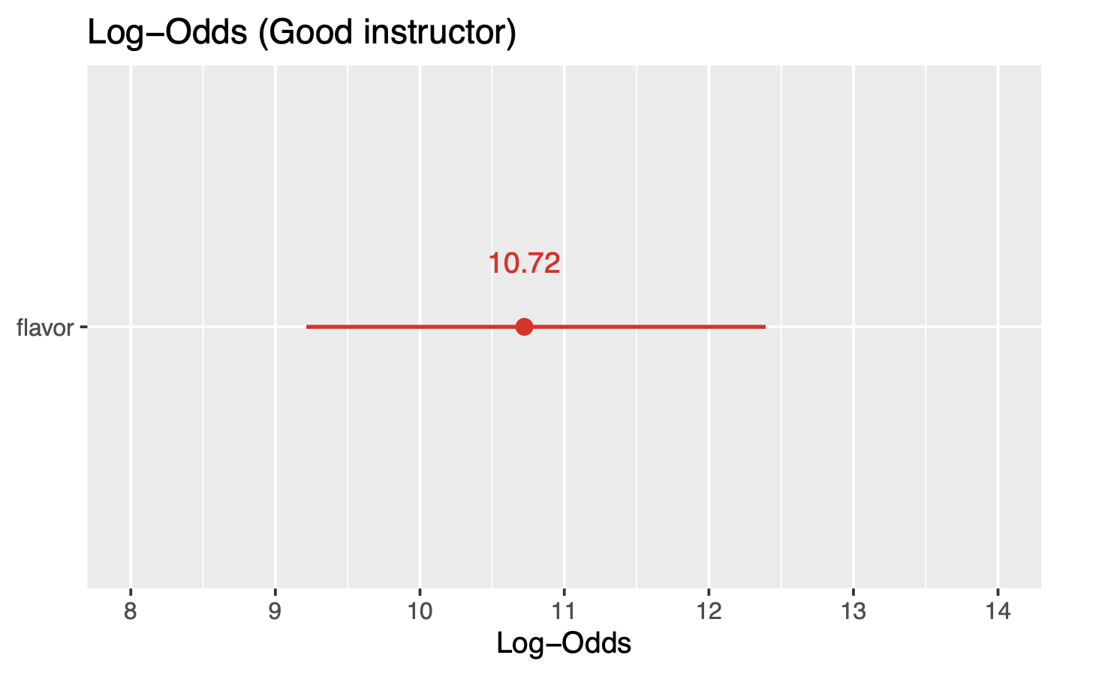
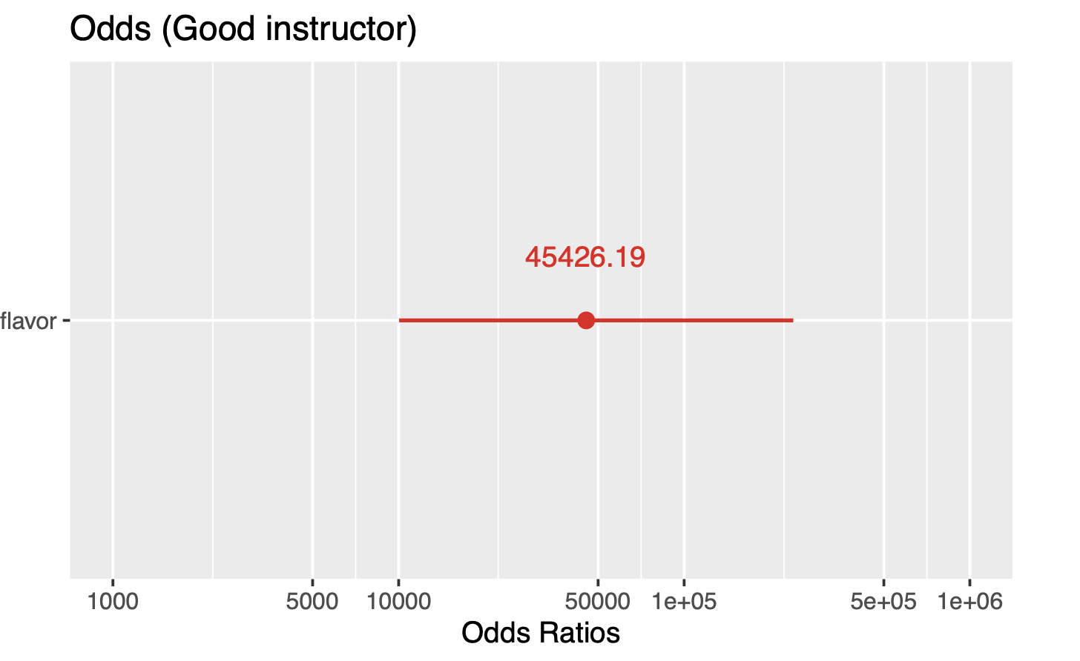


Exploratory Data Analysis
Falvor and Qualityclass
Log-odds: $\ln{\frac{p}{1−p}= α+β×falvor}⁡$
Odds: $\frac{p}{1−p}=exp(α+β×falvor)⁡$
( 9.14 , 12.31 )
( 9292.16 , 222073.05 )
The quality assessment of an instructor is strongly influenced by flavor, where both the odds ratios and log-odds suggest a sharp uptick in the probability of a positive evaluation with higher flavor scores.

Slide 5
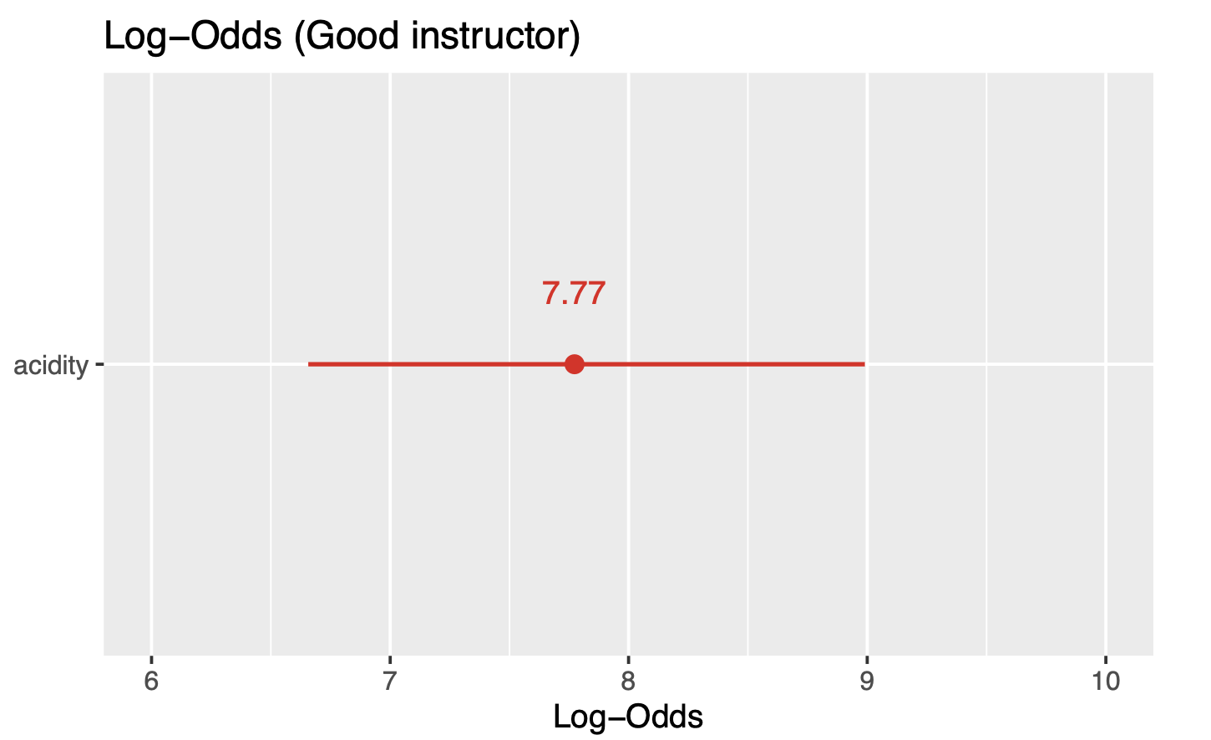
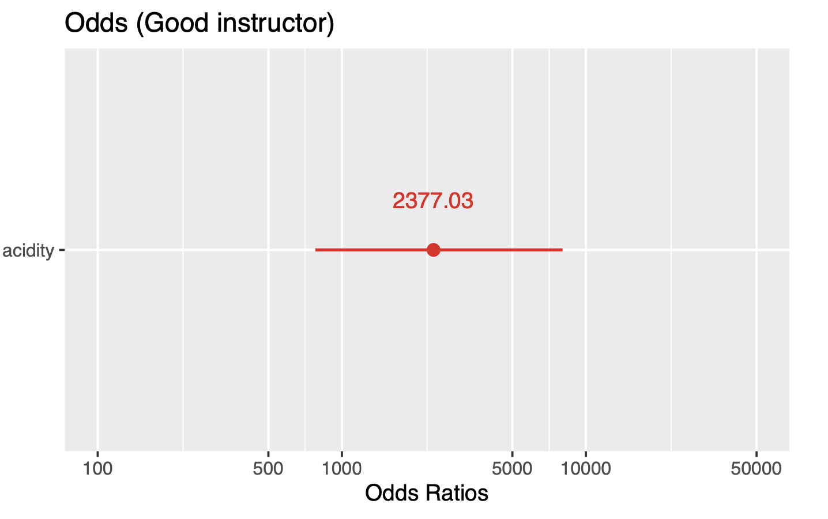


Exploratory Data Analysis
Acidity and Qualityclass
Log-odds: $\ln{\frac{p}{1−p}= α+β×acidity}⁡$
Odds: $\frac{p}{1−p}=exp(α+β×acidity)⁡$
( 6.61 , 8.94 )
( 741.35 , 7621.58 )
The quality assessment of an instructor is strongly influenced by Acidity too.

Slide 6
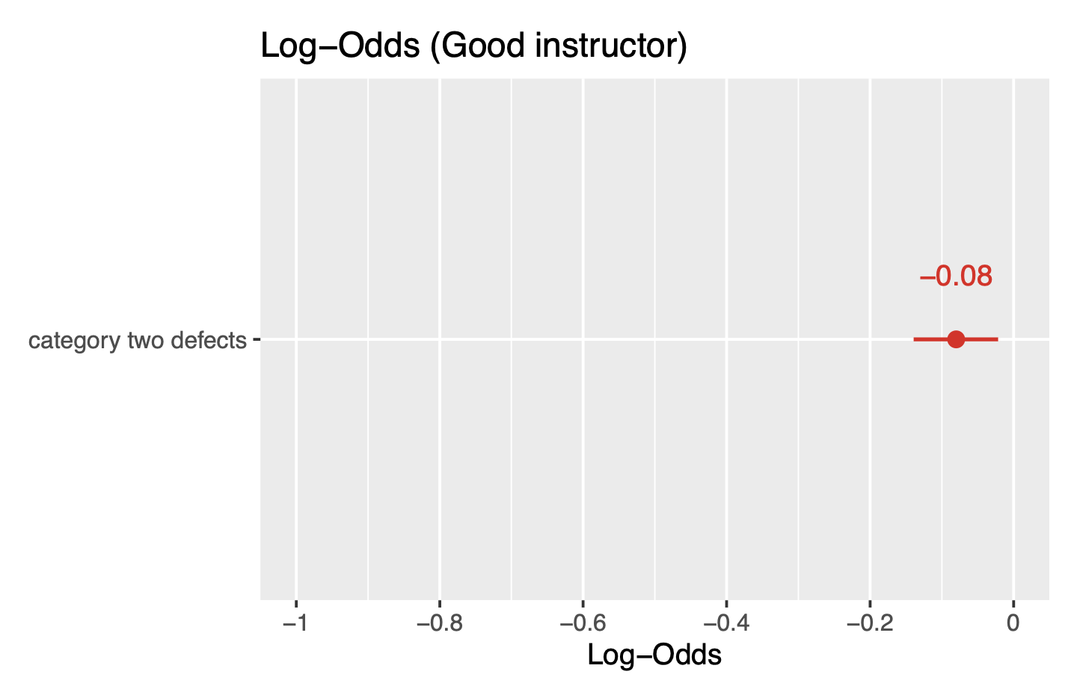
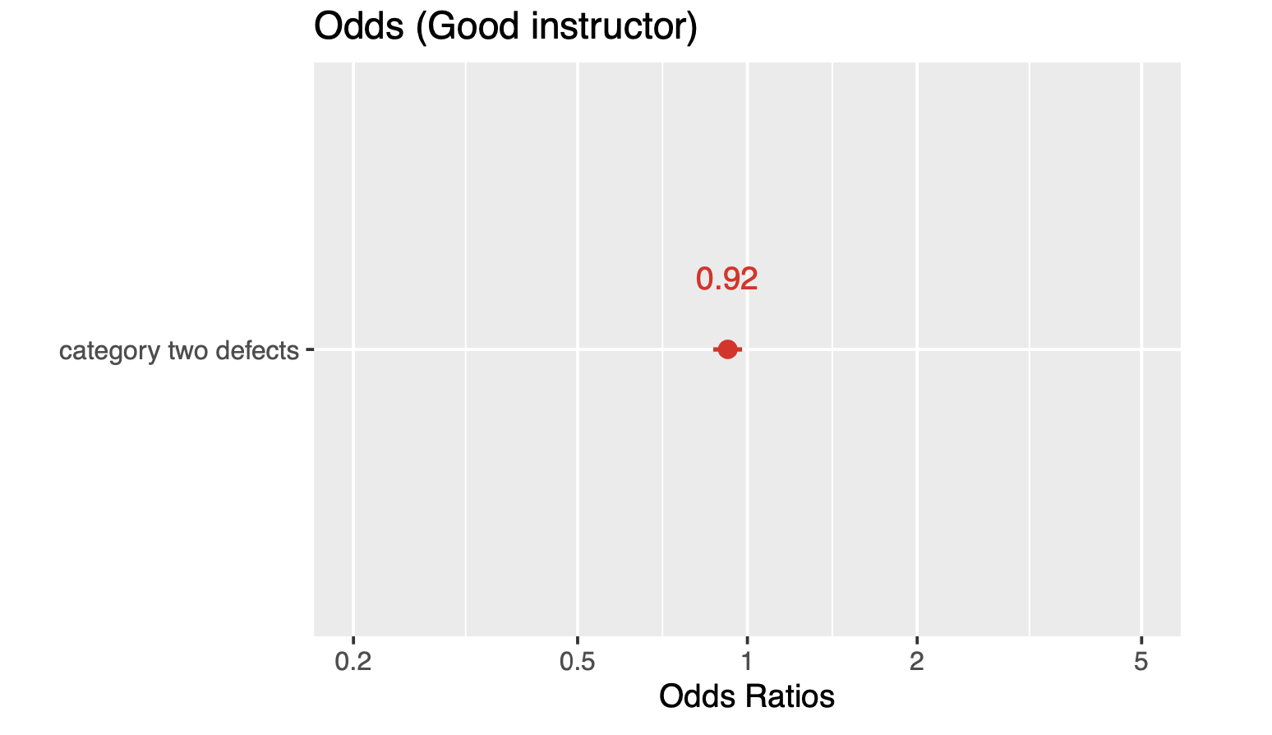


Exploratory Data Analysis
Category 2 type defects and Qualityclass
Log-odds: $\ln{\frac{p}{1−p}= α+β×defects}⁡$
Odds: $\frac{p}{1−p}=exp(α+β×defects)⁡$
( -0.13 , -0.02 )
( 0.87 , 0.98 )
For the category of two defects, an increase in defects correlates with a reduced likelihood of coffee being classified as high quality, as demonstrated by the odds ratio below one and the negative log-odds.

Slide 7
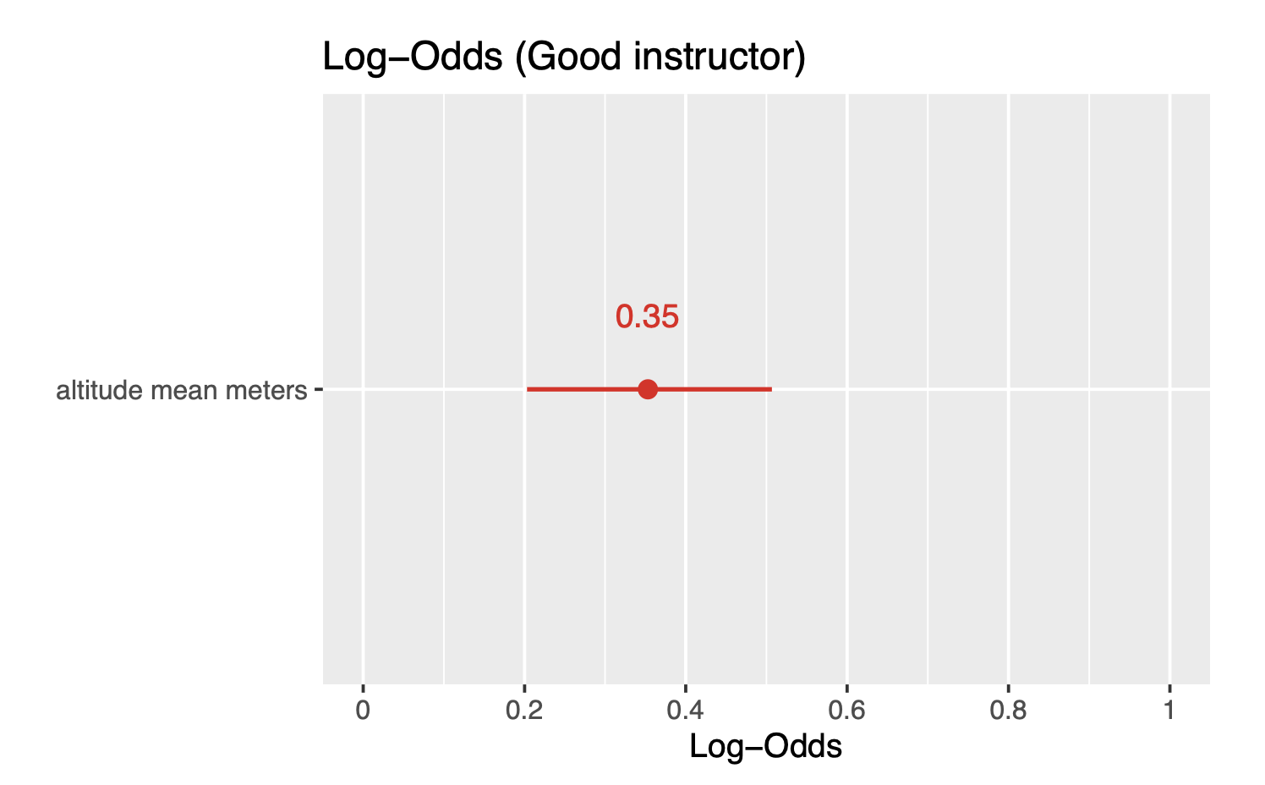
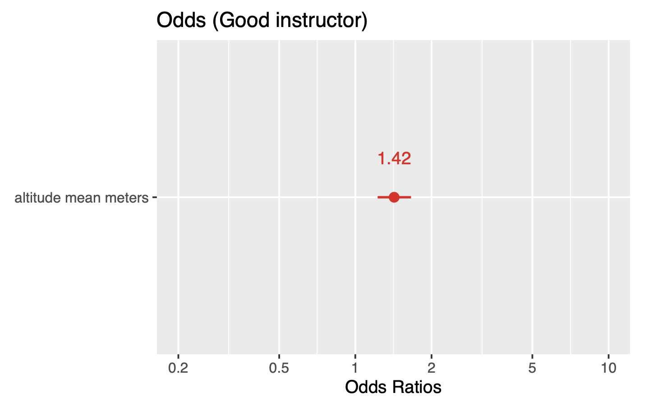


Exploratory Data Analysis
Altitude mean meters and Qualityclass
Log-odds: $\ln{\frac{p}{1−p}= α+β×altitude}⁡$
Odds: $\frac{p}{1−p}=exp(α+β×altitude)⁡$
( 0.20 , 0.50 )
( 1.22 , 1.66 )
The altitude at which coffee is grown also plays a significant role in quality. Higher altitudes are generally associated with higher coffee’s quality.

Slide 8
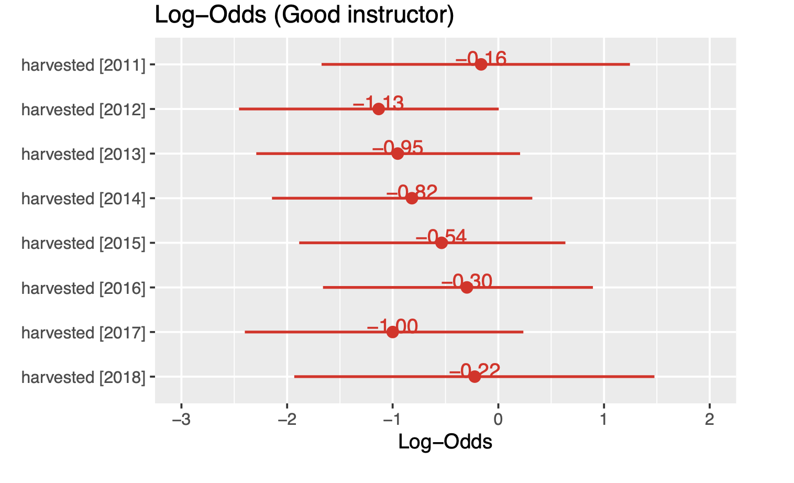
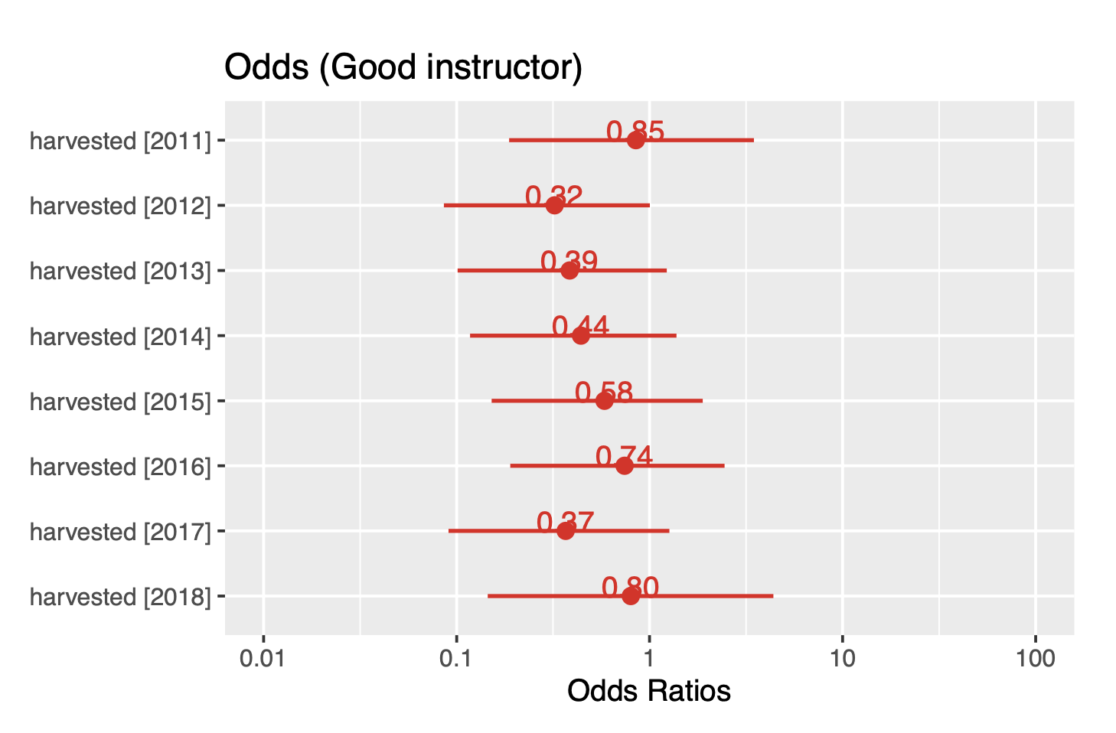


Exploratory Data Analysis
Harvested and Qualityclass
Log-odds: $\ln{\frac{p}{1−p}= α+β×harvested}⁡$
Odds: $\frac{p}{1−p}=exp(α+β×harvested)⁡$
Coffee beans harvested in 2010, 2011, 2016, and 2018 exhibit a predicted probability exceeding 50% for being of high quality, whereas those from other analyzed years fall below this threshold.

Slide 9
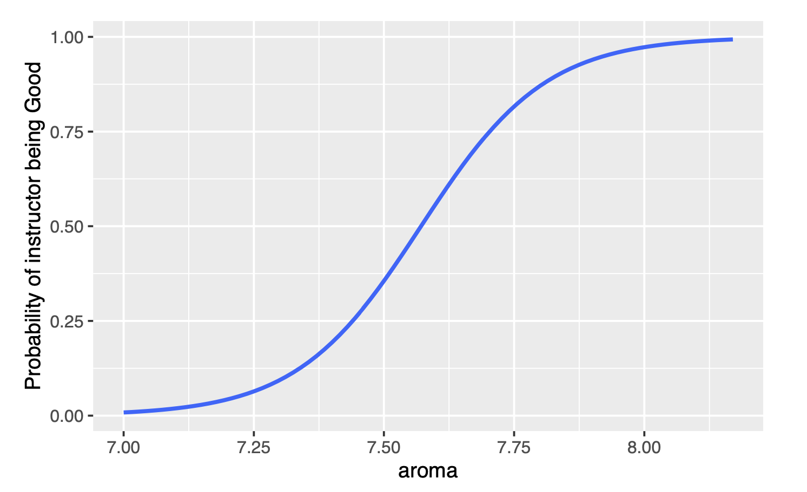
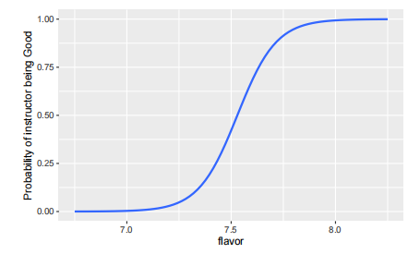
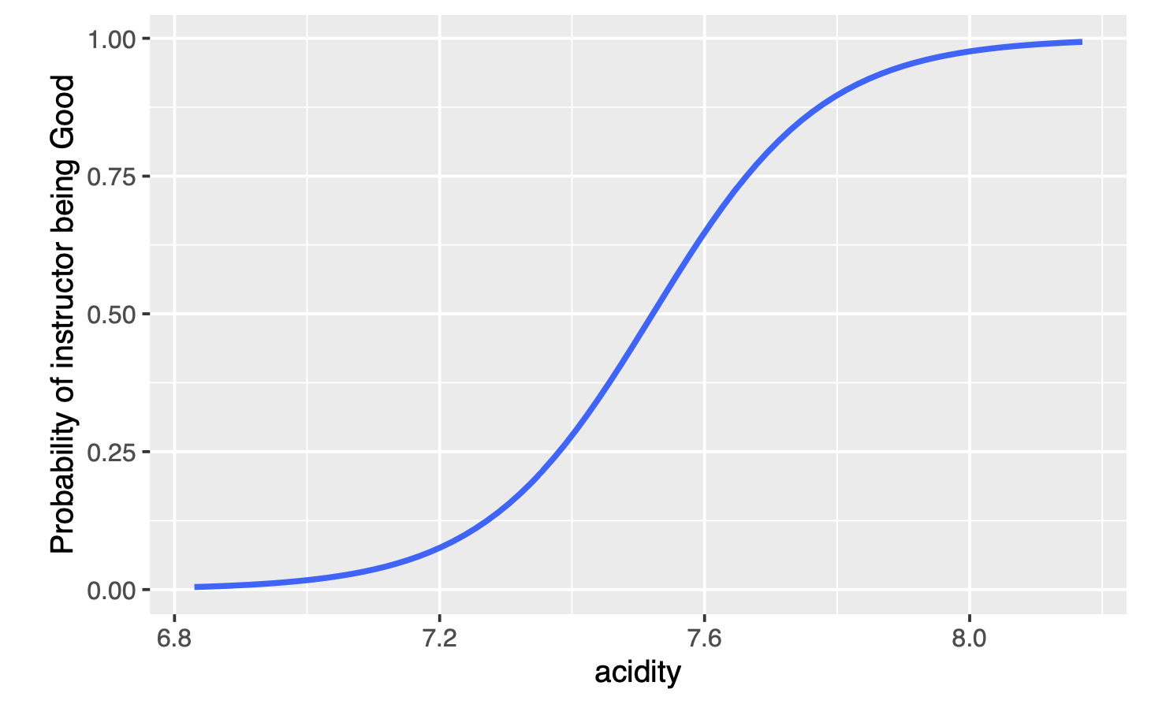
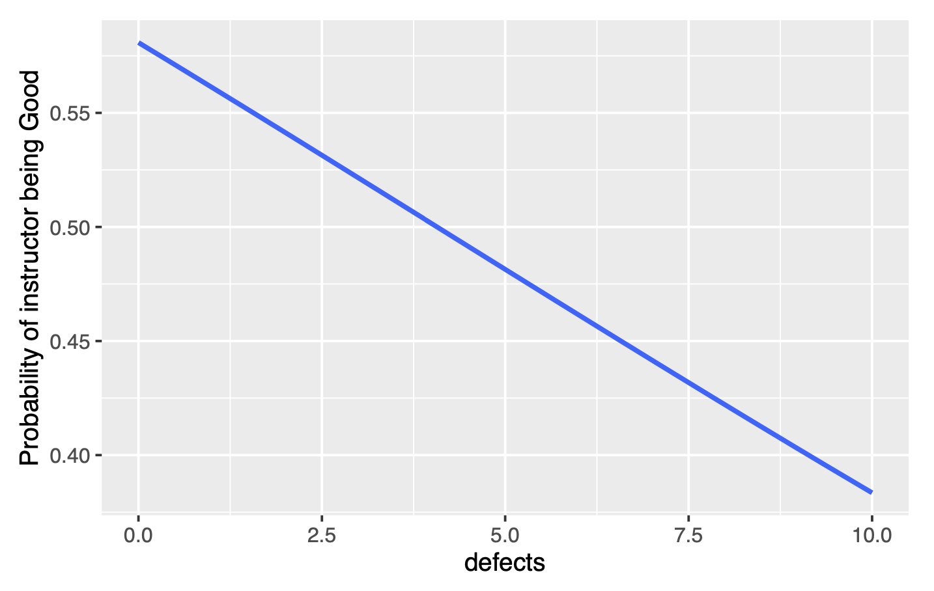
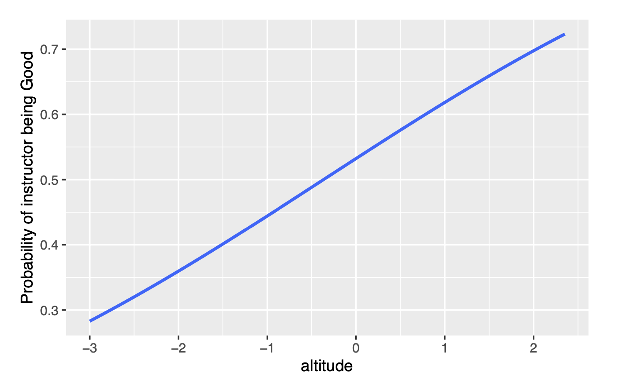
Exploratory Data Analysis
Predicted Probabilities
Aroma
Flavor
Acidity
There is a downward trend, meaning that an increase in the number of defects decreases the probability that the beans will be rated "Good.
The upward trend in the curve suggests that improvements in these characteristics are associated with an increase in the likelihood of beans being rated "good."
Defects
Altitude
Notes:
第一、二、三、张图分别显示了咖啡豆的香气（aroma）、风味（flavor）和酸度（acidity）与其被评为“Good”品质的概率之间的关系。呈曲线向上趋势，这些特征的提高与咖啡豆被评为“Good”的概率增加相关。
第四张图显示了咖啡豆的缺陷数量（defects）与被评为“Good”品质的概率之间的关系。呈现一个向下的趋势，意味着缺陷数量的增加会降低咖啡豆被评为“Good”的概率。
第吴张图揭示了种植咖啡豆的海拔高度（altitude）与咖啡品质之间的关系。曲线向上表明海拔高度的增加可能与咖啡豆品质的提升相关。

Slide 10
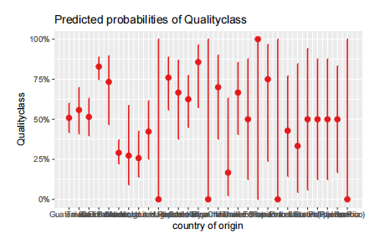
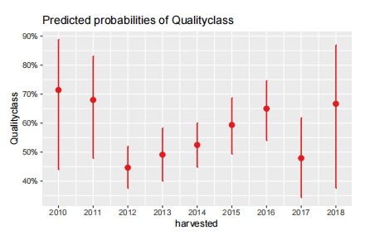
Exploratory Data Analysis
Predicted Probability
Country
Harvested

